Slide 1

SmartShelf AI
Real-Time Inventory and Theft Monitoring System for Retail Stores
A low-cost, scalable smart shelf monitoring system designed to help large retail environments reduce inventory stockouts and minimise in-store theft using affordable IoT sensors and lightweight analytics.
- KARUNYA V

Slide 2
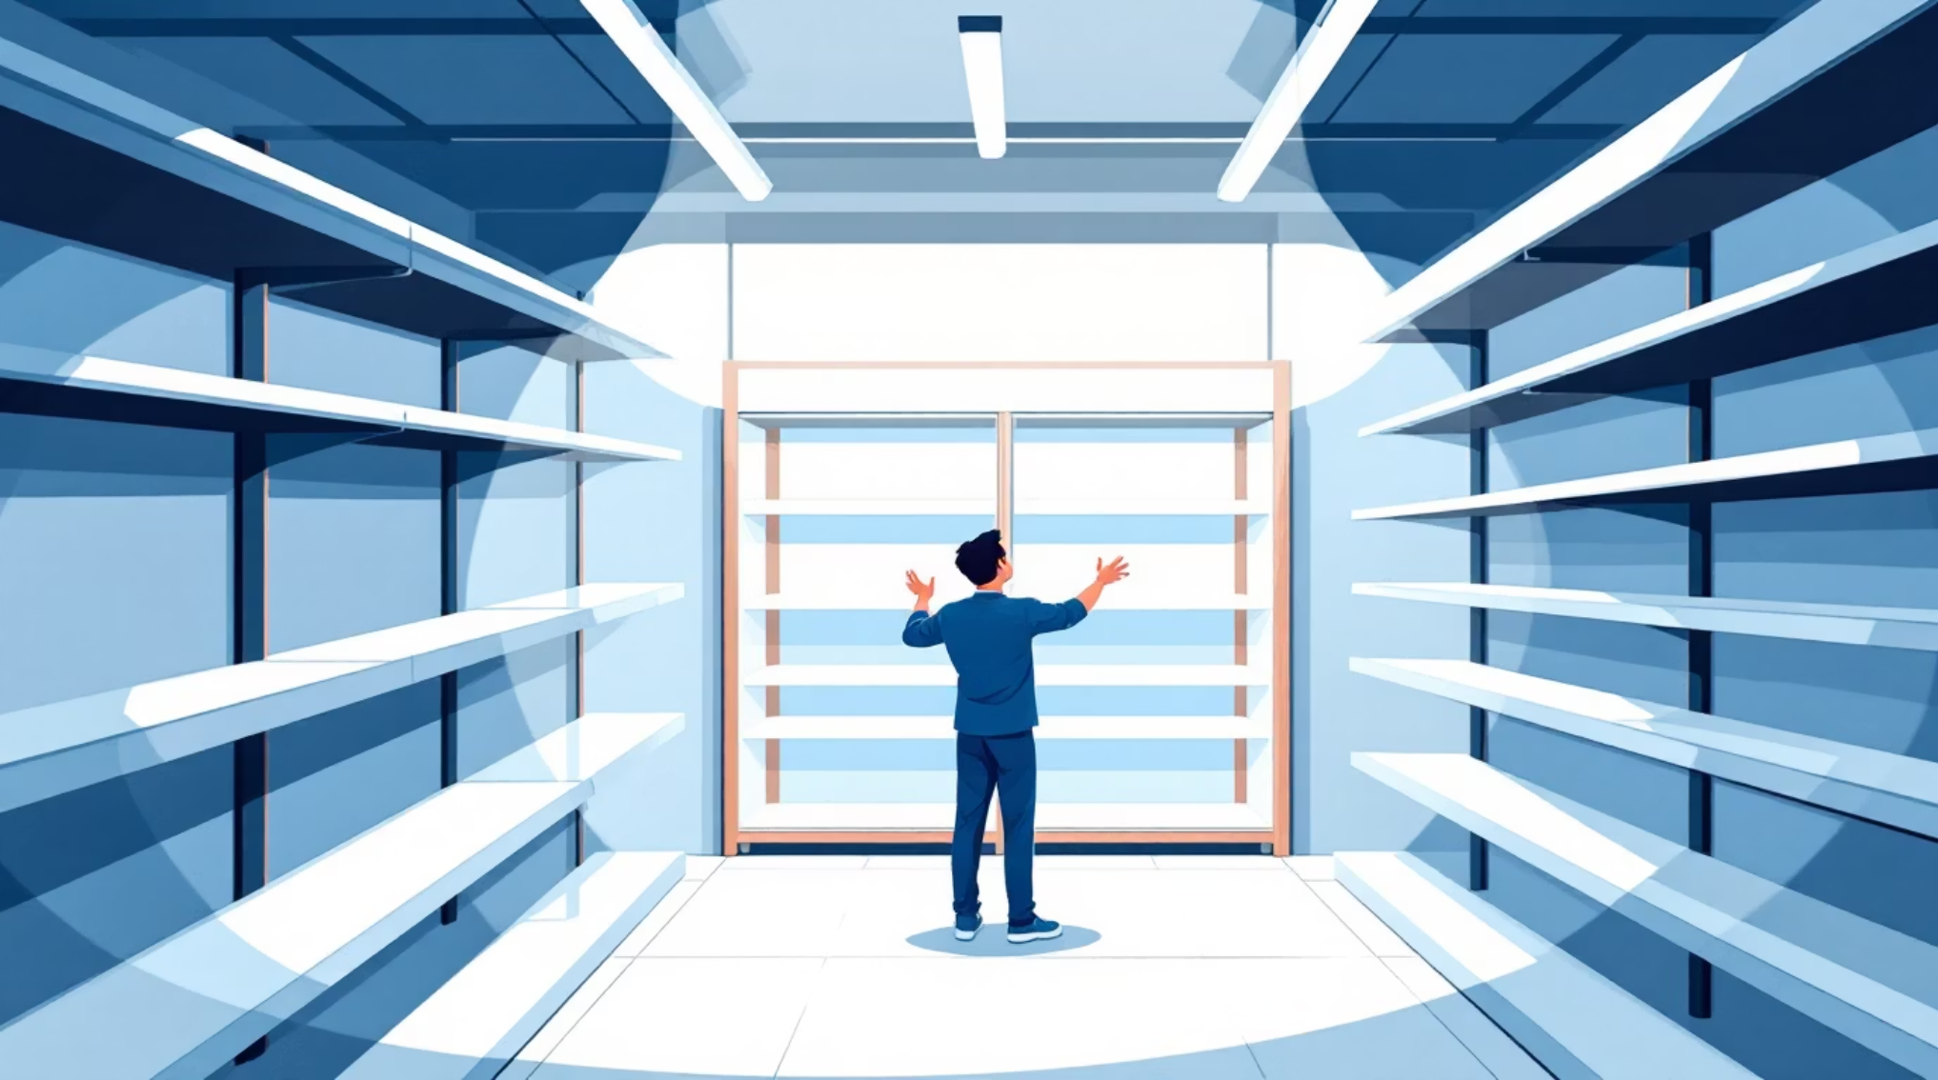
CHALLENGE
Problem Statement
Retail stores face persistent challenges in maintaining optimal inventory levels and preventing losses due to theft. Manual shelf monitoring is inefficient, whilst existing automated solutions are often expensive and difficult to scale.
Delayed Detection
Limited Visibility
High Costs
Low stock levels identified too late
No real-time shelf activity insights
Advanced monitoring systems too expensive

Slide 3


SOLUTION
Solution Overview
SmartShelf AI addresses these challenges by continuously monitoring shelf activity using weight sensors, distance sensors, and optional vision-based analysis. The system detects product removal events, identifies suspicious behaviour, and alerts store staff when inventory falls below predefined thresholds.
The design prioritises affordability, scalability, and ease of deployment, making it suitable for large retail chains.

Slide 4
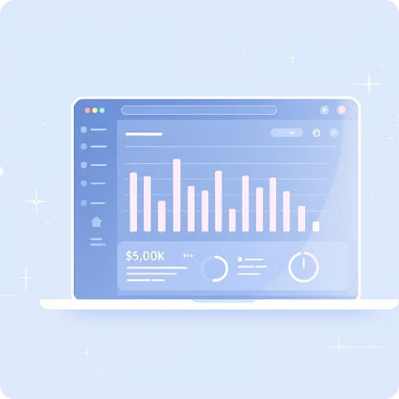



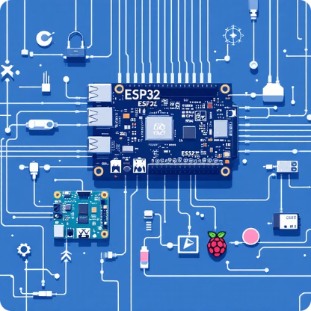
Key Features
Real-Time Inventory Monitoring
Theft Detection Support
Instant Alerts and Notifications
Low-Cost and Scalable Architecture
Identifies suspicious product removal events where items are not returned to the shelf.
Detects stock level changes using load cells and triggers alerts when restocking is required.
Sends alerts to a cloud dashboard or local indicators such as LEDs or buzzers.
Built using inexpensive components that can be deployed across multiple shelves.
Modular and Flexible Design
Supports both ESP32 and Raspberry Pi platforms, with optional camera integration.

Slide 5

System Architecture
Sensor Layer
The system consists of a sensor layer, processing unit, cloud backend, and monitoring interface. Sensor data is processed locally and transmitted to a cloud platform for visualisation and alert management.
Processing Unit
Cloud Backend
Monitoring Interface
Sensor Layer
Processing Unit
Cloud Backend
Monitoring Interface
Captures shelf activity data
Analyses data locally
Stores and manages alerts
Displays real-time insights

Slide 6
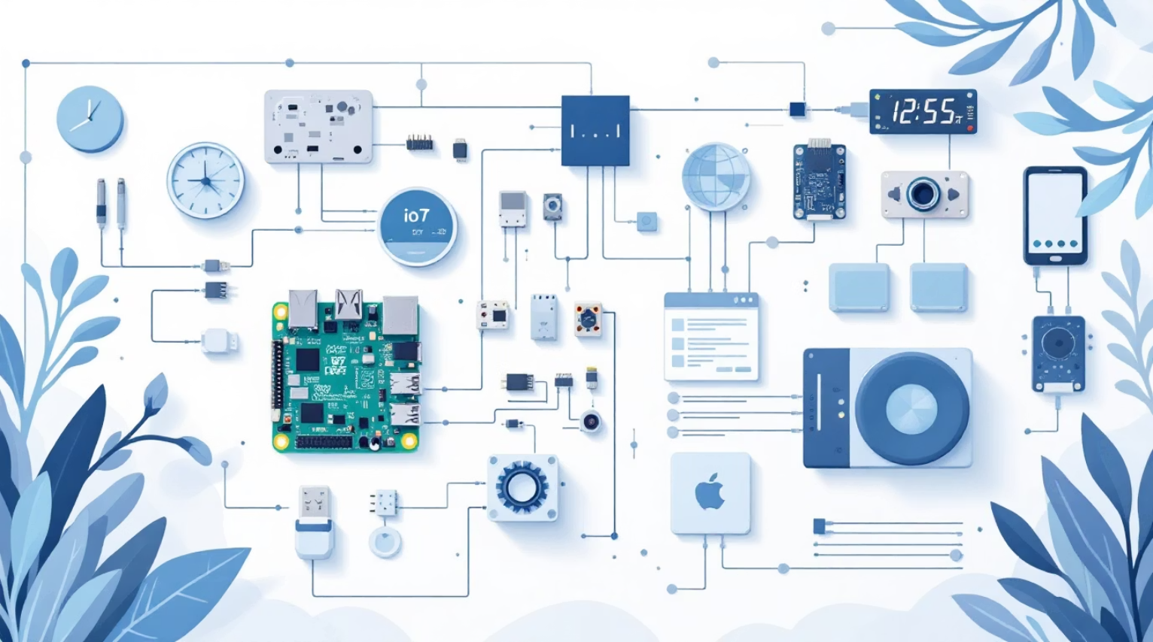
Hardware Components
The system uses affordable, readily available components to ensure cost-effectiveness and scalability across large retail environments.
Component
Purpose
Cost
Raspberry Pi / ESP32
Central controller
₹3,000 / ₹500
Load Cell with HX711
Weight detection
₹350
Ultrasonic Sensor
Presence detection
₹100
Pi Camera / USB Camera
Visual monitoring
₹400–₹700
LED / Buzzer
Local alerts
₹50
Wi-Fi Module
Cloud communication
₹200
Power Supply
Circuit setup
₹300

Slide 7





Software Stack
Embedded System
Arduino IDE, Python
Backend / Cloud
Firebase, Flask, Google Sheets
Data Processing
Python
Monitoring / ML
OpenCV (Optional)
Dashboard / UI
Streamlit, ReactJS, Web Application

Slide 8
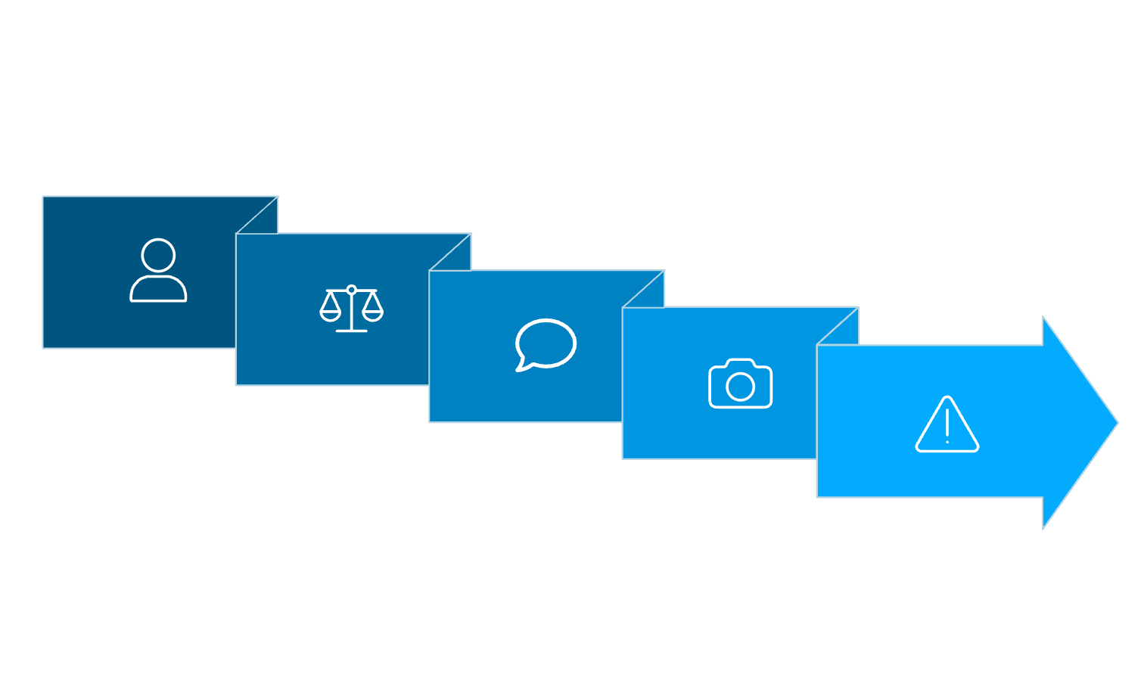





System Workflow
01
Product Removal
Customer removes item from shelf
02
Weight Detection
Customer Removes
Load cell detects change in weight
Return Verified
03
Suspicious Alert
Return Verification
Ultrasonic sensor checks if item returned
04
Weight Detected
Behaviour Analysis
Optional camera analyses interaction
Behavior Check
05
Alert Generation
Suspicious activity triggers alert
06
Restocking Alert
Low inventory notification sent

Slide 9


PROTOTYPE
Prototype Demonstration Setup
Physical Setup
Miniature shelf structure with integrated load cell and mock product items
Processing Unit
ESP32 or Raspberry Pi as the central controller
Alert System
Alerts displayed through LEDs, buzzer, or cloud dashboard
Real-Time Monitoring
Live logs visible in Firebase or web interface

Slide 10




Potential Use Cases
Large Retail Chains
Warehouses and Distribution Centres
High-Value Product Shelves
Automated Inventory Systems
Supermarkets and department stores requiring scalable inventory monitoring
Automated stock tracking in large-scale storage facilities
Enhanced security for premium items prone to theft
Integration with existing retail management platforms

Slide 11


